Slide 1
Introductory General Chemistry
Chemistry 3A
Experiment 8a
Determination of Gas Constant R
Mitch Halloran

Slide 2
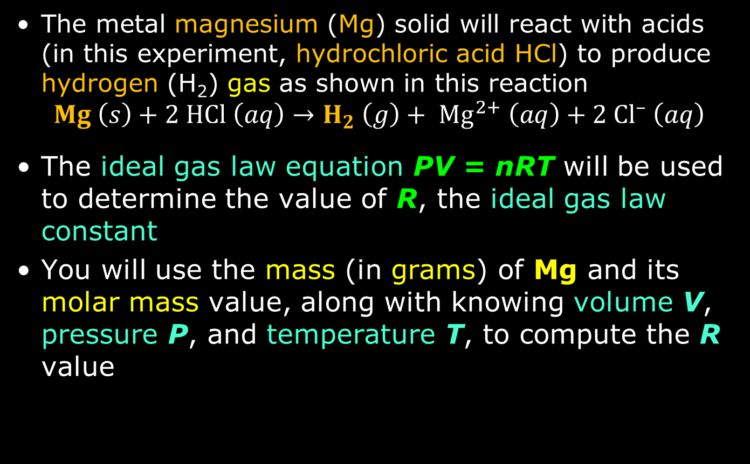
Introduction
The metal magnesium (Mg) solid will react with acids (in this experiment, hydrochloric acid HCl) to produce hydrogen (H₂) gas as shown in this reaction
$$Mg \left(s\right)+2 HCl \left(aq\right)→H_{2} \left(g\right)+ {Mg}^{2+} \left(aq\right)+2 {Cl}^{–} \left(aq\right)$$
The ideal gas law equation PV = nRT will be used to determine the value of R, the ideal gas law constant
You will use the mass (in grams) of Mg and its molar mass value, along with knowing volume V, pressure P, and temperature T, to compute the R value

Slide 3
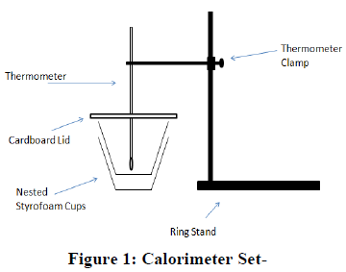
Background
When a solid is dissolved in a liquid (solvent), there can be an energy change related to the molecules of the solid interacting with the molecules of the solvent.
When heat is released in dissolving, reaction is exothermic
When heat is absorbed in dissolving, reaction is endothermic

Slide 4
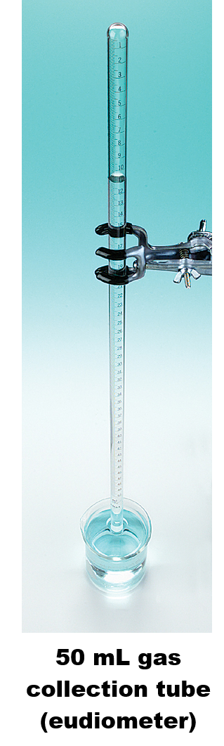
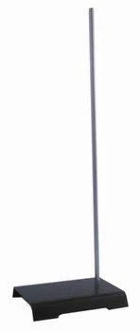
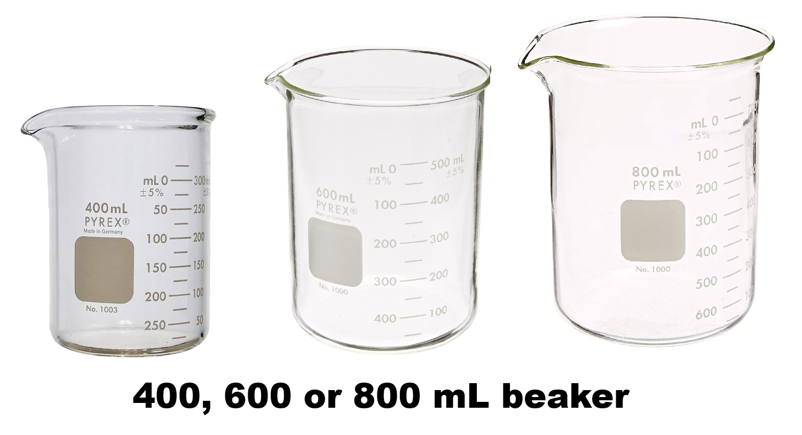
Equipment You Will Use

Slide 5
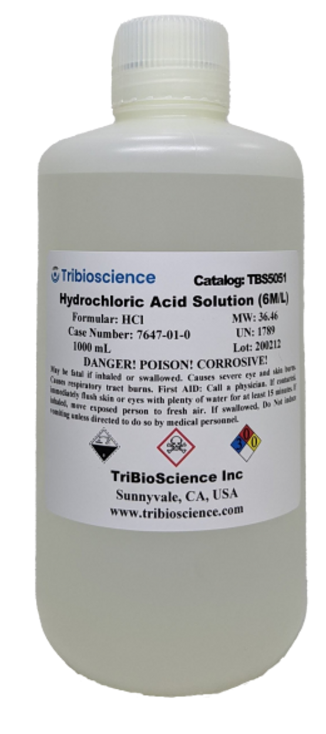
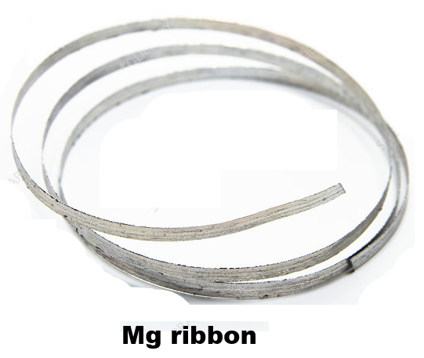
Consumables

Slide 6
Pre-Lab Preparation/Questions
A pre-lab quiz has been made for you
THIS IS AN EXTRA CREDIT quiz that is worth 15% (30 points) of the value of a lab report (200 points). I suggest you do the quiz if you have been wanting extra credit points for the course
It will help you understand and complete this laboratory report as well
The quiz is at this URL

Slide 7
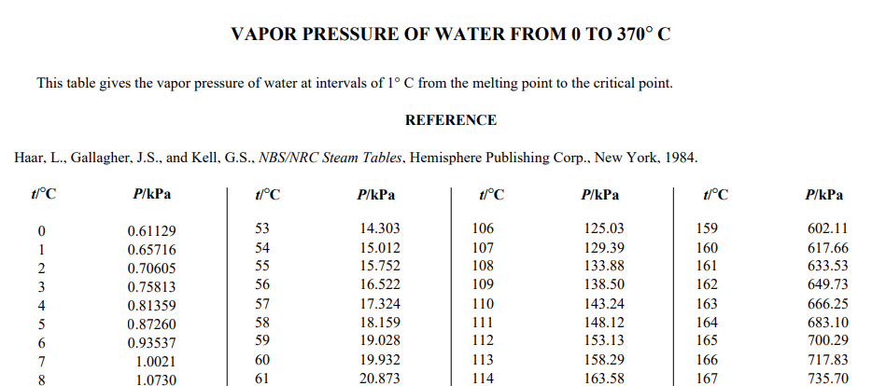
CRC Handbook
Your lab manual wants you to look up a reference for the water vapor at a particular temperature
The manual mentions an authoritative reference called the CRC Handbook of Chemistry and Physics
Fortunately, this reference is available online at this link
This is a PDF which may load directly in your browser
If you did a search for “water vapor” or “vapor pressure” inside the PDF, you would find the table you are looking for. The “vapor pressure” search worked in this case.
You can use this table, but you might have to convert to other pressure units (keep this in mind)
For your citation: write in the URL. You can even add at the end of the URL the string “#page=<page number you find>” and it will go straight to the page

Slide 8
Procedure
Magnesium ribbon: DO NOT HANDLE THE RIBBON WITH BARE HANDS!!! ONLY HANDLE Mg ribbon with gloves! Otherwise it might irritate your hands
Clean the Mg ribbon by lightly rubbing with steel wool. It may become “shiny” as an oxide outer layer is removed
Put weighing paper on the balance, zero it, and put the ribbon on the balance: you are looking for a target mass of about 0.05 g (50 mg). If the mass > 0.05 g, estimate carefully how much ribbon to break off, break it, then re-weigh it to get the final mass you will use. Record the mass (all the digits from the balance) in your lab manual

Slide 9
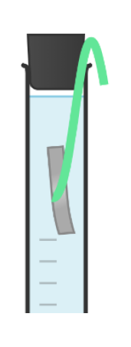
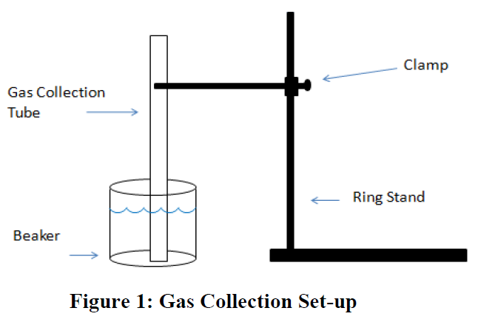
Procedure
You need to break off the ribbon so as not to lose too much mass: you will need to tie your Mg ribbon to fishing line (~15 cm long)
Set up the clamp on a ring stand and beaker as shown in figure below. Fill the beaker halfway with water

Slide 10
Procedure
Using a small (10 mL) graduated cylinder, pour 8-10 mL of 6 M (molar) hydrochloric acid (HCl) into the gas collection tube (eudiometer)
For this step of adding DI water, I suggest you first tip the eudiometer tube at an angle so that the water comes in down the side of the wall of the eudiometer tube. VERY SLOWLY AT FIRST add water to the eudiometer to avoid MIXING the water with the acid. As you add more water, the mixing effect will lessen but still add it slowly. Bring the level of the water to the brim of the eudiometer tube, this time holding the tube quite vertically.
Put the Mg ribbon in the water JUST INSIDE THE TUBE. Some of the fishing line should be OUTSIDE the tube.
Place a rubber stopper in the tube, making sure it holds the fishing line

Slide 11
Procedure
Put your GLOVED finger over the hole in the rubber stopper: INVERT the tube with your finger still over the hole and immerse your gloved hand—finger still over the hole—into the beaker of water. Quickly but carefully put the tube in the clamp and hold it. You can remove your finger but only with tube with stopper immersed in beaker water.
Use a thermometer to record beaker water temperature to nearest 0.1°C. Also get the classroom barometric pressure
The reaction is done WHEN
There are no bubbles forming
The Mg ribbon is not visible
The headspace gas is not increasing
You might want to ask your instructor if he thinks the reaction is complete
Record volume of gas produced.

Slide 12
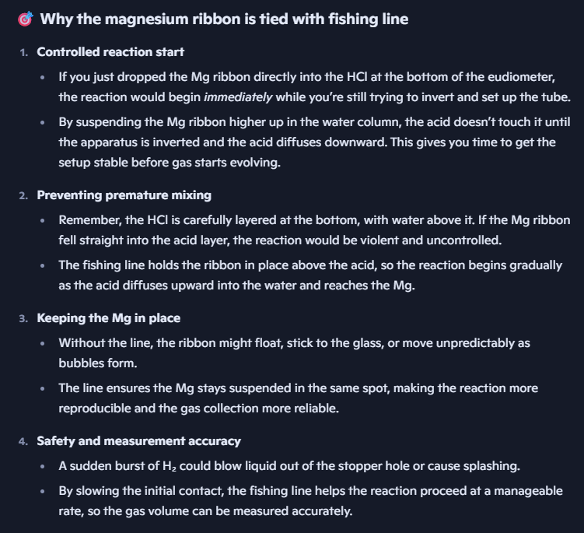
The Fishing Line: Why?

Slide 13
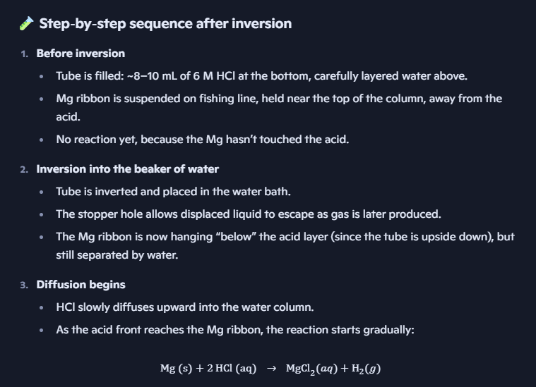
Details of Reaction

Slide 14

Details of Reaction

Slide 15
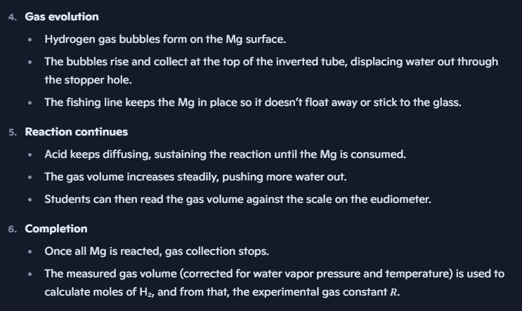
Details of Reaction

Slide 16
Clean Up
Lift the tube and remove the stopper to allow the contents of the tube to drain in the beaker water
Take the beaker—which contains the strong HCl acid—to the sink. Use the NaHCO₃ solid at your bench and add very small amounts of it to the beaker to neutralize the acid. When it stops producing gas, it is neutralized. Pour the contents in the sink while running the tap water (not DI) for a minute or so
Rinse the beaker out with small amounts of DI water with some swirling. Do this 2-3 times. Place the beaker where it belongs. It is not essential to dry it out with a paper towel
The eudiometer tube should be filled up a couple of times with DI water and the rinse discarded in sink.

Slide 17
Example Data Analysis
Use the mass of Mg ribbon to calculate the theoretical yield of H₂ gas
Calculate the pressure of H₂ gas using the atmospheric pressure and the vapor pressure of H₂O. Conver the pressure to atm units
Use the PV=nRT equation to calculate R.
Calculate a percent error
Do not determine significant digits until the final calculation: record all the digits from your calculator for intermediate calculations

Slide 18
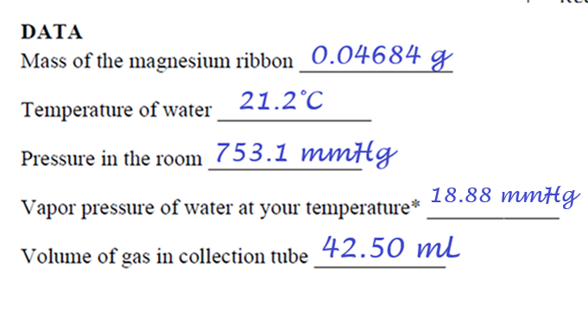
Example Data Analysis
These are all EXAMPLE DATA, but probably close to what your data will look like

Slide 19
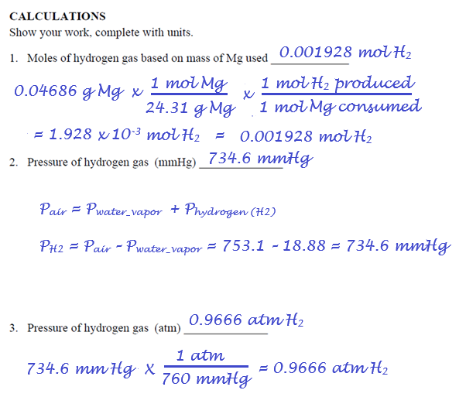
Example Data Analysis

Slide 20
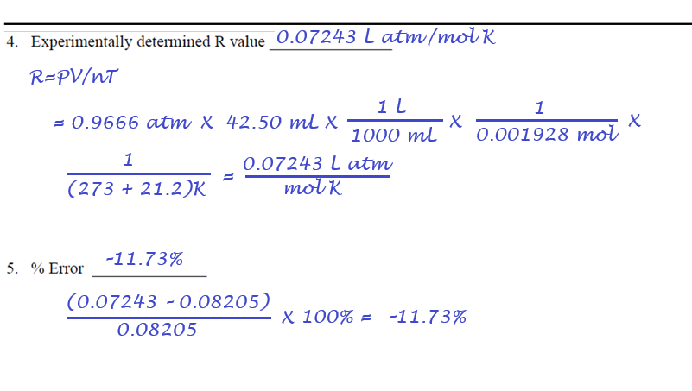
Example Data Analysis

